Slide 1
Importance of international harmonisation
Alexander Kühn CEPT

Slide 2
Baseline for spectrum regulation: Harmonisation
Technical Regulatory
Aspects
Economic and Competion
Aspects
Legal and Procedural Implementation
International Specifications & Agreements

Slide 3
Why harmonise spectrum ?
Larger Markets
Predictability of regulation
Economies of scale
More Services
In-time regulation
Avoid harmful interference
Easy Regulation
Consumer benefits
Best practicies
Balancing interests
Ease cross-border coordination
Greater Efficiency

Slide 4
Regulatory framework for spectrum use
GLOBAL
Radio Regulations
Recommendations
Reports
REGIONAL
Decisions
Recommendations
Decisions, Reports,
Recommendations
(Harmonised) Standards
Government
NATIONAL
National Regulatory Authority (NRA)
Governmental users
Authorisations (individual or general)

Slide 5
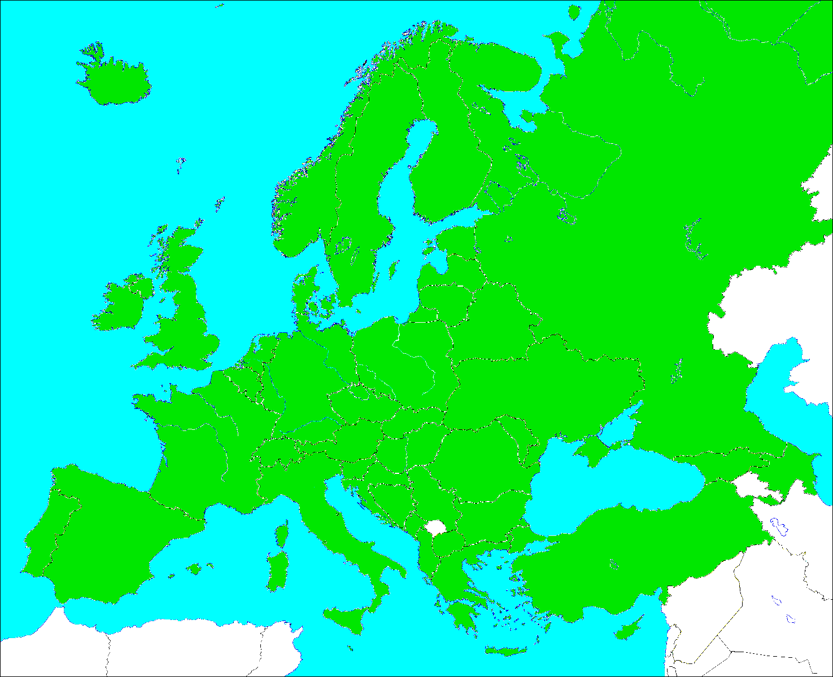
CEPT 48 Members

Slide 6
CEPT
Support
Council
CERP
Germán Vázquez Asenjo - ESP
Manuel Costa Cabral - POR
Eric Fournier - FR
ECO
COM - ITU
Chairmen form the Presidency
ECC
Support
WG‘s
TG‘s
PT‘s
the support of the ECO is also available for the subgroups of the other committees

Slide 7
Electronic
Communications Committee
Chairman: E. Fournier (F)
Vice-Chairmen: S. Pasthuk (RUS) J. Afonso (POR)
Steering Group
Director: P. Christensen (DNK)
Deputy Director: B. Espinosa (F)
WG CPG
WG FM
WG SE
WG NaN
Conference
Preparatory Group
Frequency
Management
Spectrum
Engineering
Numbering
and Networks
Chairman:
A. Kühn (D)
Vice-Chairman:
G. Osinga (HOL)
A. Vallet (F)
Chairman:
T. Weilacher (D)
Vice-Chairmen:
S. Talbot (G)
L. Bodusseau (F)
Chairman:
K. Loew (D)
Vice-Chairmen:
J. Duque (POR) k. Bejuk (HRV)
ECC PT1
Chairman:
J. Vallesverd
(NOR)
Vice-Chairman:
E. Greenberg (G)
F. Dragomir (ROU)
IMT-Matters
Chairman:
S. Green (G)
Vice-Chairmen:
V. Poskakukhin (RUS)
V. Milas (GRC)
Project-teams
Project-teams
Project-teams
Project-teams

Slide 8
ECC Transparency
Open participation rules
Project teams open for partners and ETSI members
Working groups and the ECC open for LoU and MoU representatives
Others can request access to be granted by the related chairman
Access to documentation
All deliverables are at www.erodocdb.dk (including related EC Decisions)
All contributions and minutes of meetings are at www.cept.org/ecc
The European database on spectrum information (EFIS) is at www.efis.dk
Don’t be misled by the Login. Documents are only protected if so requested by the contributor.

Slide 9
CEPT- ECC Process
ECC-Working Group
„Frequency Management“
ECC Recommendation
ECC
Report
ECC Decision
ECC Recommendation
ECC
Report
ECC-Working Group
„Spectrum Engineering“

Slide 10
700 MHz Development
Background: WRC-12 Decision on the „almost allocation“ of 694-790 MHz band to the Mobile Service
Threefold strategic activities started:
Preparation towards WRC-15 (AI 1.2) – incl. SAB/SAP
Studies on 700 MHz (Regulatory – Compatibility)
Cross-border Issues (BS-MS / ARNS-MS)
Clear strategic objective on a harmonised solution
Less discretion for national administrations (except: Implementation)
Lesson from Digital Dividend I (800 MHz) – „UHF Strategy“

Slide 11
Benefits 700 MHz Harmonisation
Predictability for
Mobile industry (manufacturers)
Broadcasting operators
CEPT administrations regarding regulatory environment
Strengthening of CEPT position to WRC-15
Early ECP
Common Crossborder-Framework (ARNS-MS)
Facilitating global developments
Flexibility on implementation date

Slide 12
ECC Recommendations
ERC Recommendation 70/03 on Short Range Devices
Common technical usage conditions – technological neutral
Frequencies for specific types of Short-Range devices
Flexible Guidance to CEPT administrations (non-mandatory)
Implementation usually by general authorisation
Fast spectrum access for innovative systems

Slide 13
Current issue: 5G
Strategy: CEPT Roadmap on 5G
Focus on key bands for 5G: 700 MHz, 3.4-3.8, 26 GHz
Review of ECC Decisions on all mobile bands: Ready for 5G?
WRC-19 Agenda item on millimeter wave bands (>24 GHz)
Requirements of vertical industries
Result of
Hugh dynamic in ICT development
Consensus based approach in CEPT

Slide 14
Relation to the European Union
EU is a legal community!
Legal certainty ⇨ Mandatory decisons
Harmonisation measures are based on CEPT decisions on technical conditions
EU Mandates & CEPT reports

Slide 15
Global level: ITU
Radio Regulations / WRC´s
Full support of the consensus based approach!
Concerns on regulation of specific applications
High level regulation needs high grad of abstraction!
ITU-R Recommendations
Common technical conditions
Similar element as ECC Decisions → Flexible implementation
They are not standards

Slide 16
Trends & Challenges
Future place of spectrum harmonisation?
Role of Standardisation organisations vs. interregional administration groups?
Ensuring the timely availability of spectrum
Responsiveness to dynamic technological innovation
Global vs. Regional harmonisation
SUGGESTION: More Communication !

Slide 17
Thank you!
Muchas Gracias a todo!
Vielen Dank!
Alexander Kühn
Chairman CPG-19
alexander.kuehn@bnetza.de
+49.173.3040281
Federal Network Agency
Tulpenfeld 4
53113 Bonn
Germany

